Slide 1
E-HUT
An Advance E-commerce Project

Slide 2
Group Information
Name | Id
Borno, Md. Sirajuddin | 18-36449-1
Hossain, Muntasir | 18-36421-1
Abdullah, Syed | 18-36537-1
Faisal, Mahbub Hossain | 18-37337-1

Slide 3
Motivation
Busy City Busy People
People spend too much time and money
Most of the time they can’t go to shop

Slide 4
INTRODUCTION
This project is about to study and design a web application that will provide services to busy families. This application will help them
Deliver products within fixed days of weeks and in a time range
Deliver fresh vegetables and groceries regularly
Can provide suggestion
No need to go outside to purchase their groceries
They don’t need to customize order regularly.

Slide 5
System Features
Admin:
Login
Add new admin and managers
View Retailer and delivery man information
View customer information
HR Manager:
Login
Retailer verification
Delivery man verification

Slide 6
System Features
Accounting and Finance:
Login
Manage Income and expenditure
Unregistered User:
See/search contents (groceries)
Check availability of products
See available offers.

Slide 7
System Features
Customer:
Login
View product
By shop
By category
Search
Sort
Suggestion List
Grocery suggestion list
Add to cart

Slide 8
System Features
Customer:
Checkout
Make payment (Mobile banking, Card) once in a month
View balance (adjustment with previous balance)
Service cancelation (Entirely)
Order Cancelation (Weekly/Monthly)
Feedback on product and delivery service (optional)
Discounts/Voucher/Referrals
View stats (Monthly, Category)

Slide 9
System Features
Retailer:
Self-Registration
Retailer info
Shop name
Shop Address
Bank account information
Verification
Add/Update/Disable Product
Discount/Voucher
View Review and ratings
Update delivery information

Slide 10
System Features
Delivery Man:
Self-Registration
Verification
Login
View nearest order
Accept order
Update delivery process
View Stats
View Review and ratings
Payment:
Keeping log of all transaction history.
Individual client wise payment module.
Security and authentication verification of payment cards.

Slide 11
Environments
The system will be created under windows operating system environment
The hosting server will be 99.9% uptime
This website will be platform and browser independent

Slide 12
Benefits
No hassle for buying groceries.
Customers will set their monthly budget and the system will provide a suggestion list of groceries.
Customers don't have to go outside to get their groceries.
Customers don't need to spend time thinking about grocery shopping.
It prevents customers from overspending on groceries.
Customer satisfaction.
Save time and travelling cost.
Very safe and secure payment system.
Multiple option for doing payment.
Every transaction history is recorded.

Slide 13
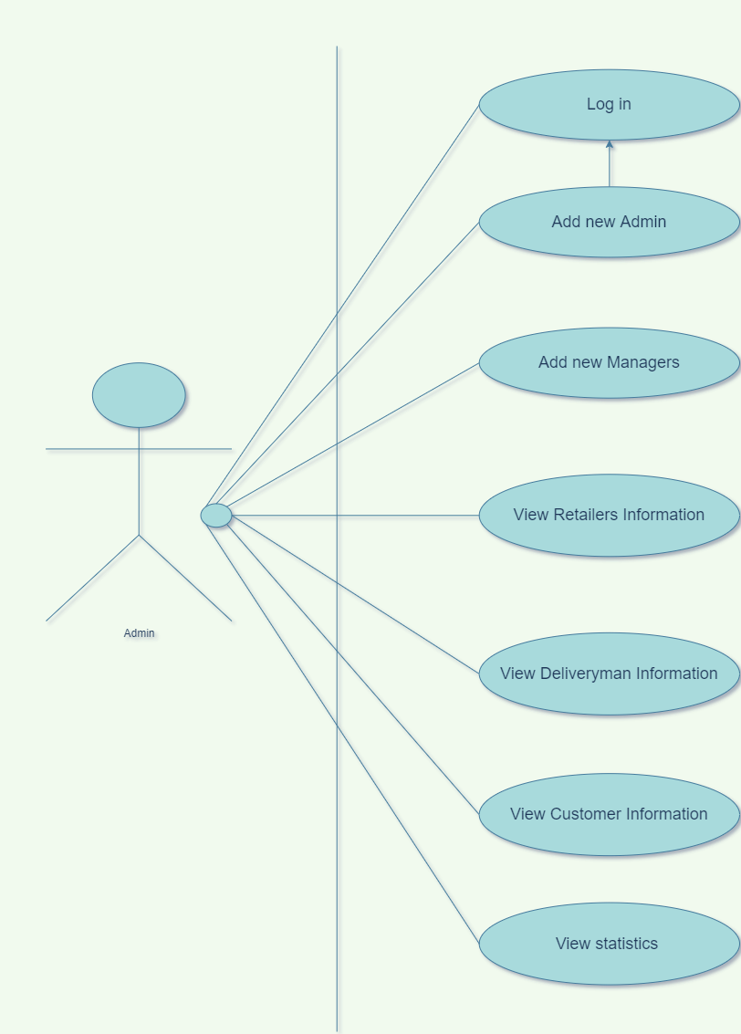
Use Case Diagram
Admin

Slide 14
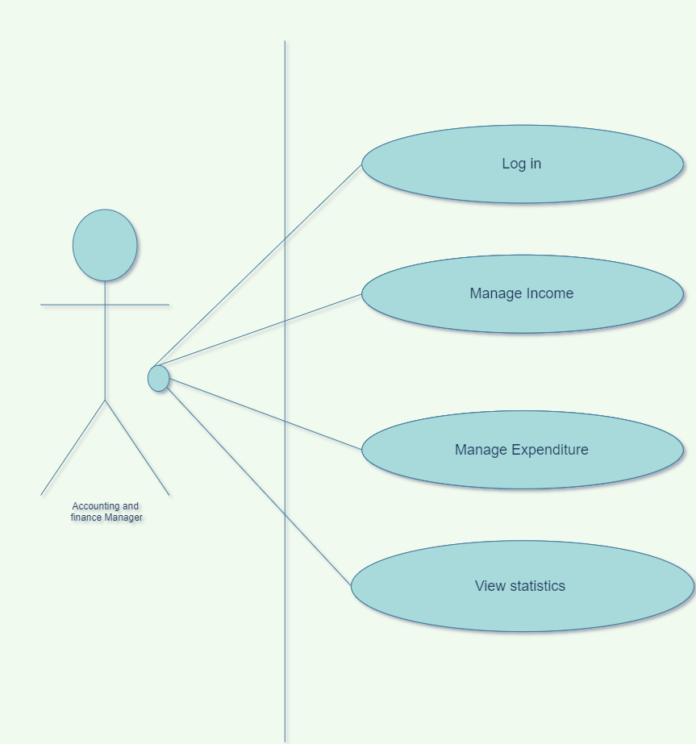
Use Case Diagram
Finance and Accounting Manager

Slide 15
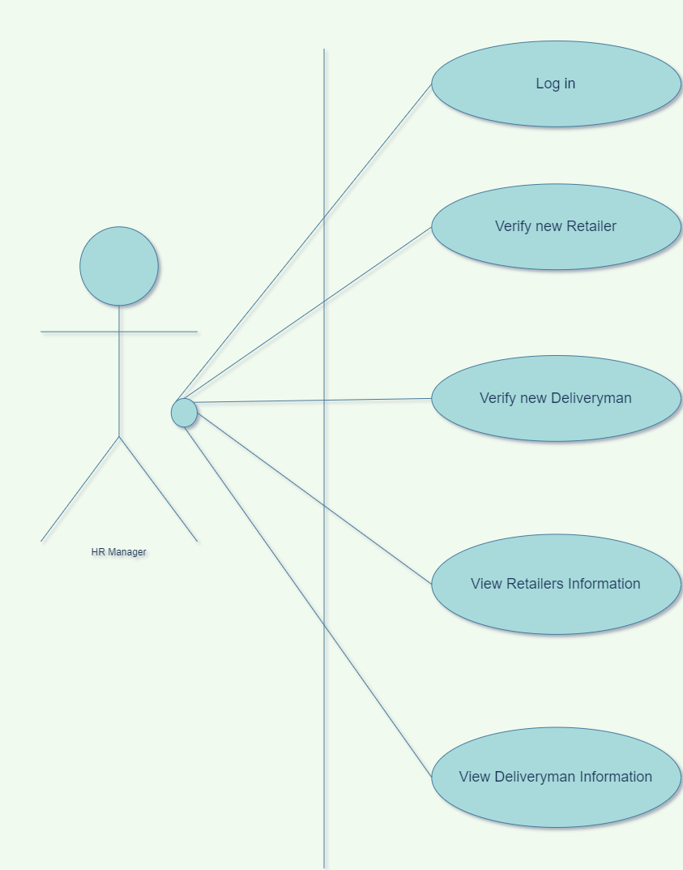
Use Case Diagram
HR Manager

Slide 16
Use Case Diagram
HR Manager

Slide 17
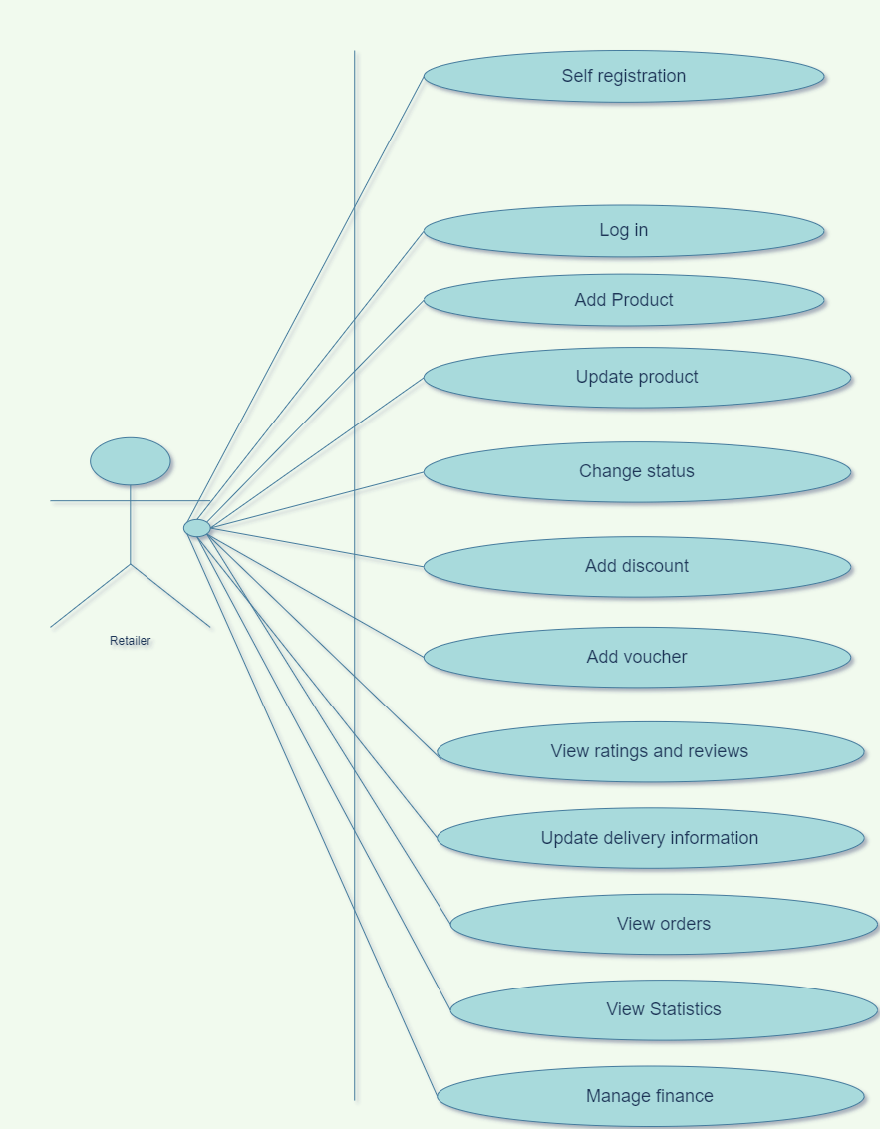
Use Case Diagram
Retailer

Slide 18
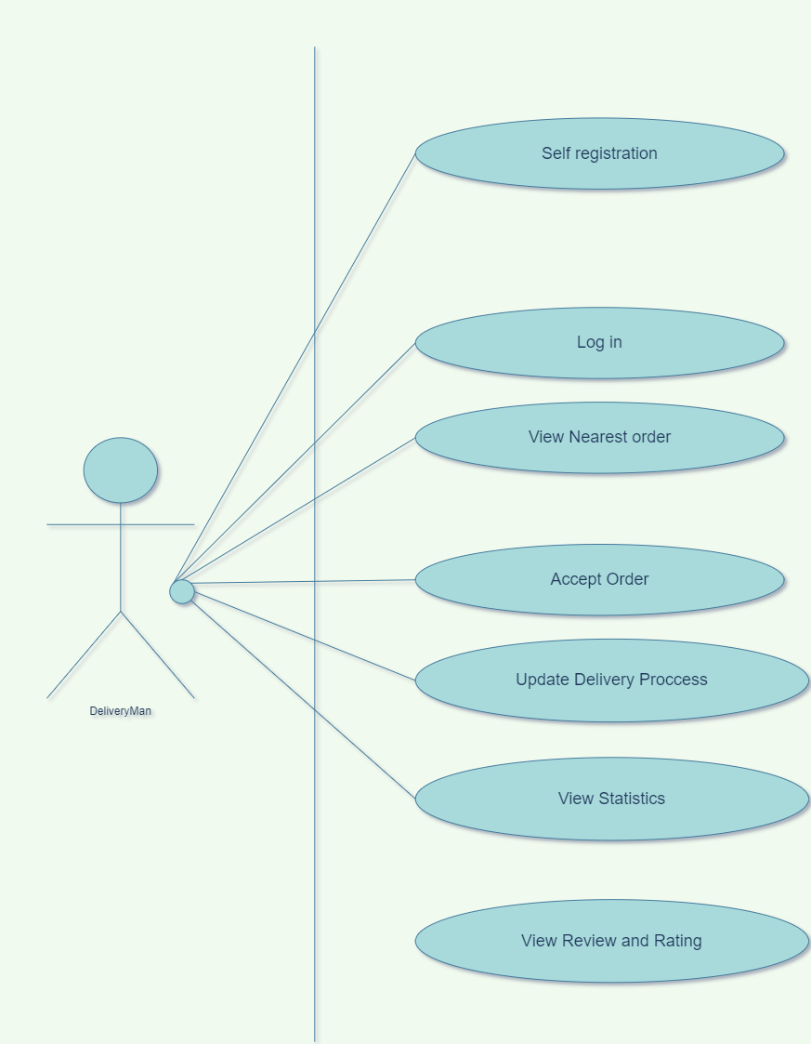
Use Case Diagram
Delivery Man

Slide 19
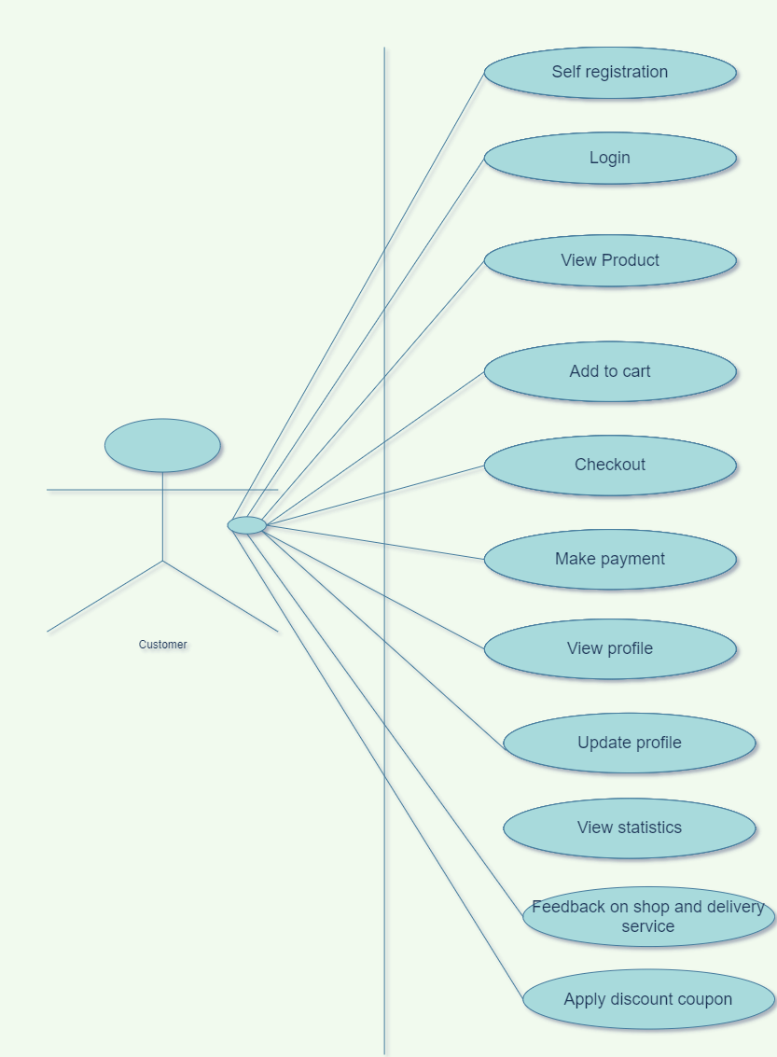
Use Case Diagram
Customer

Slide 20
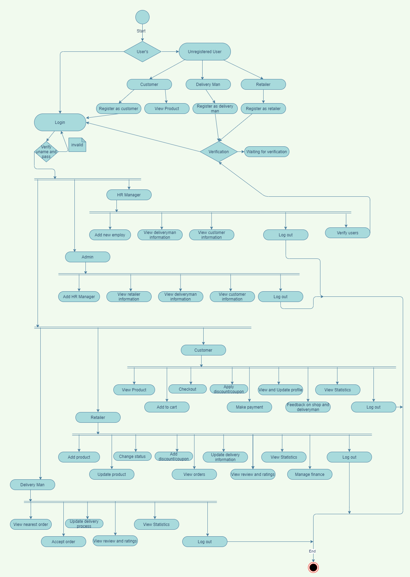
Activity Diagram

Slide 21
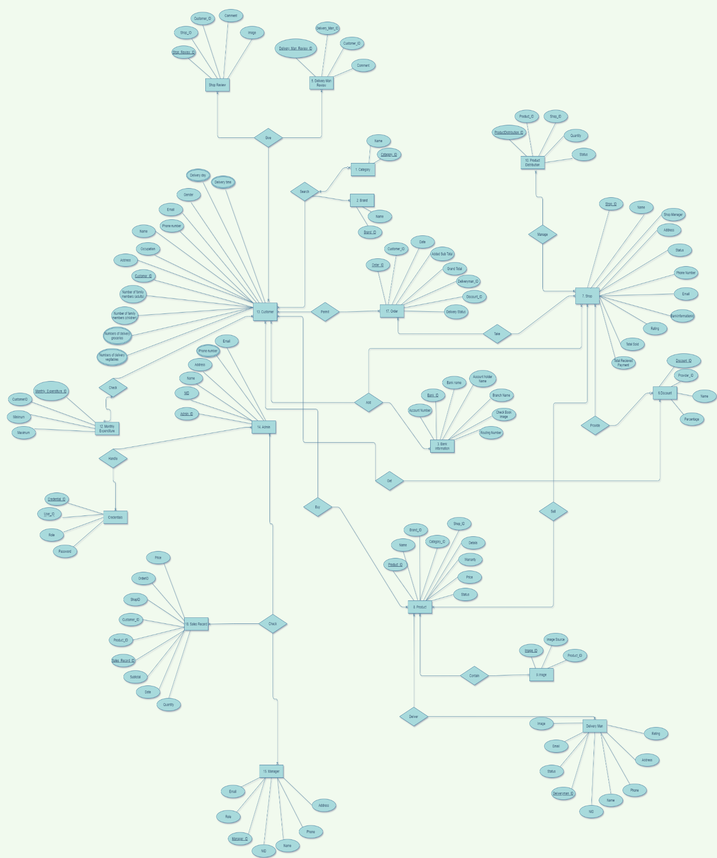
E-R Diagram

Slide 22
Class Diagram

Slide 23
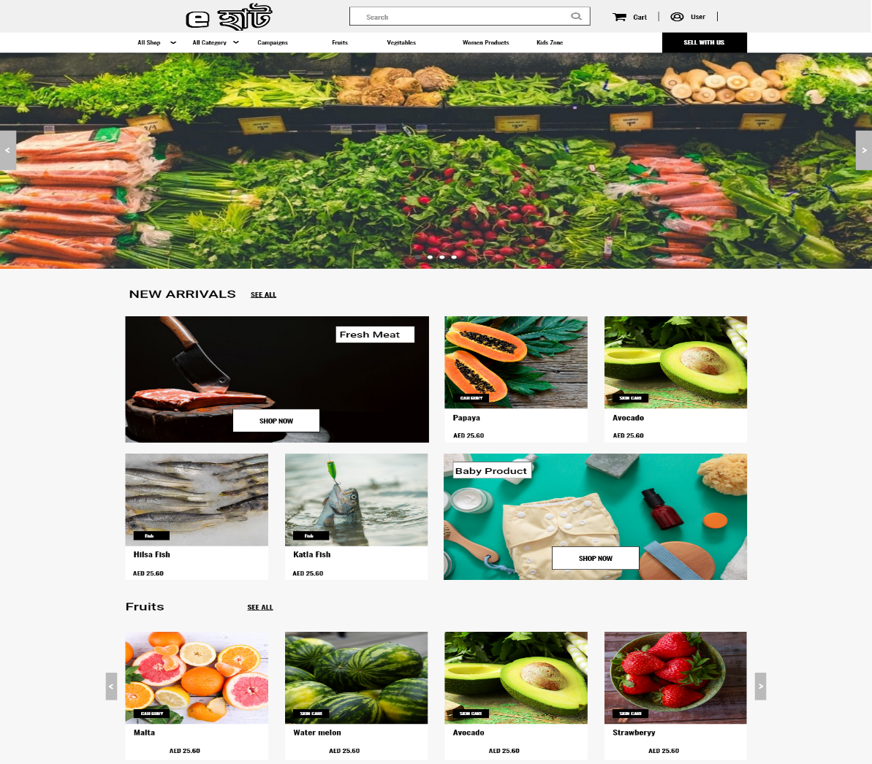
Prototype
Homepage

Slide 24
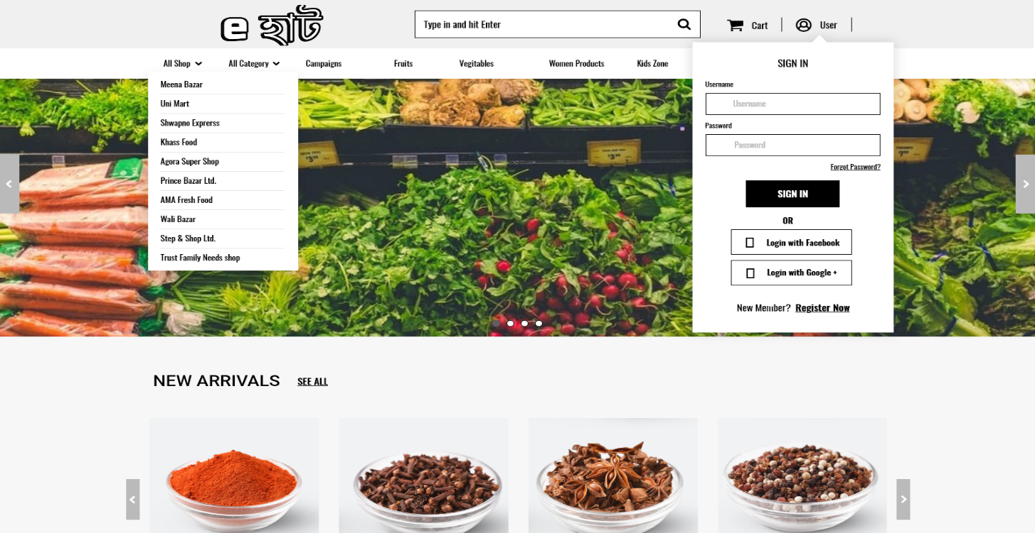
Prototype
Sign in / Registration

Slide 25
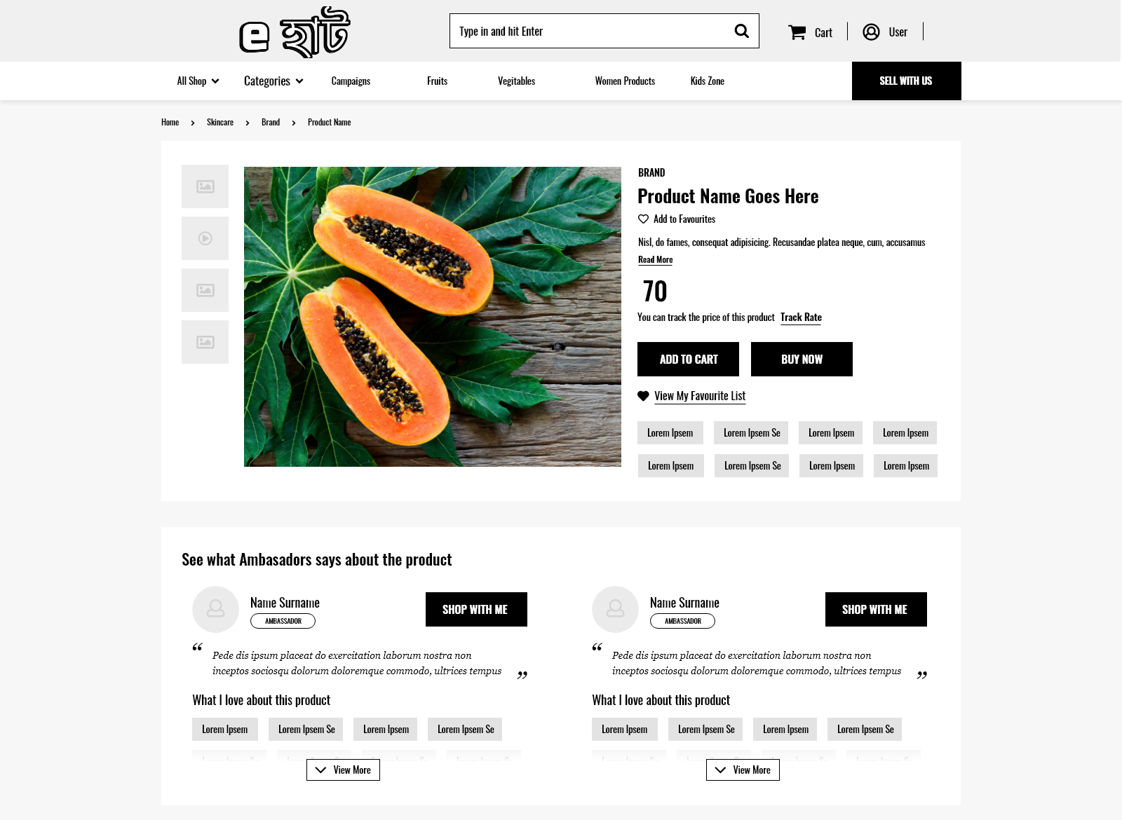
Prototype
Product Details

Slide 26
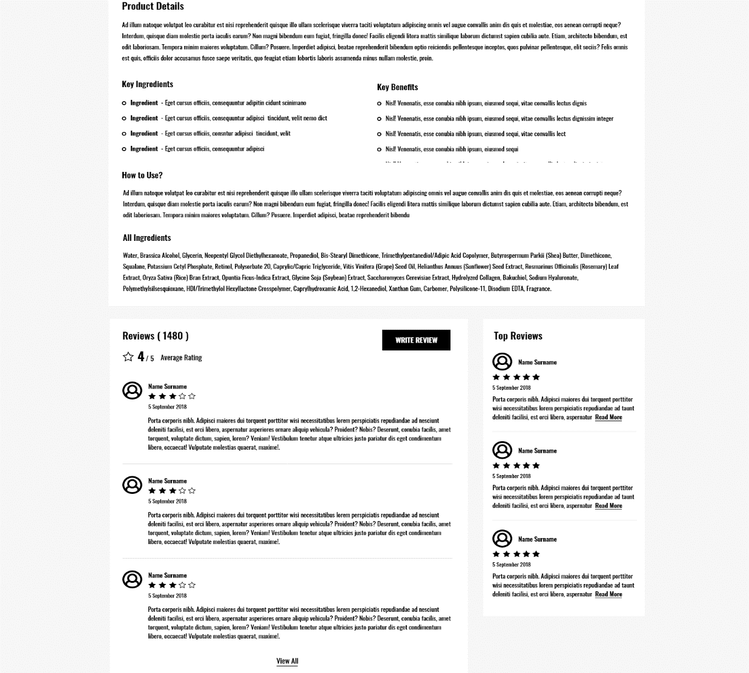
Prototype
Product Review

Slide 27
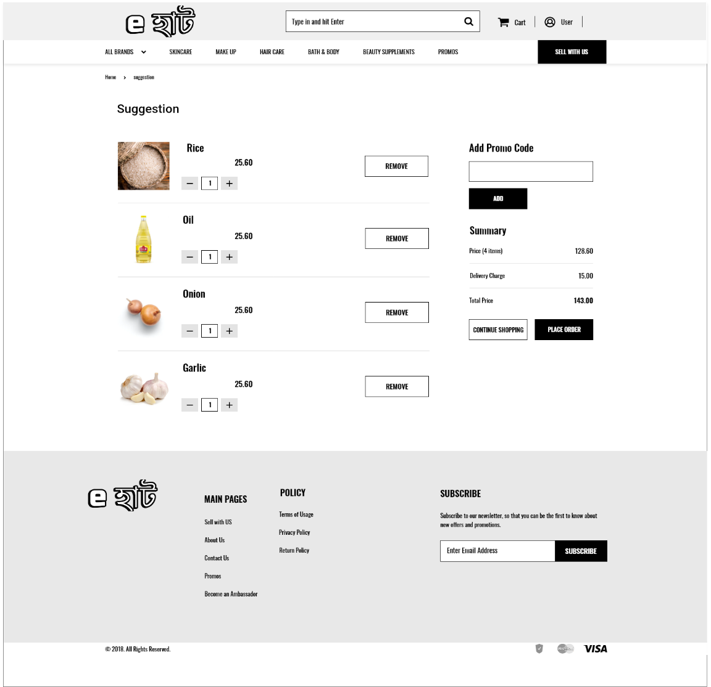
Prototype
Suggestion Page

Slide 28
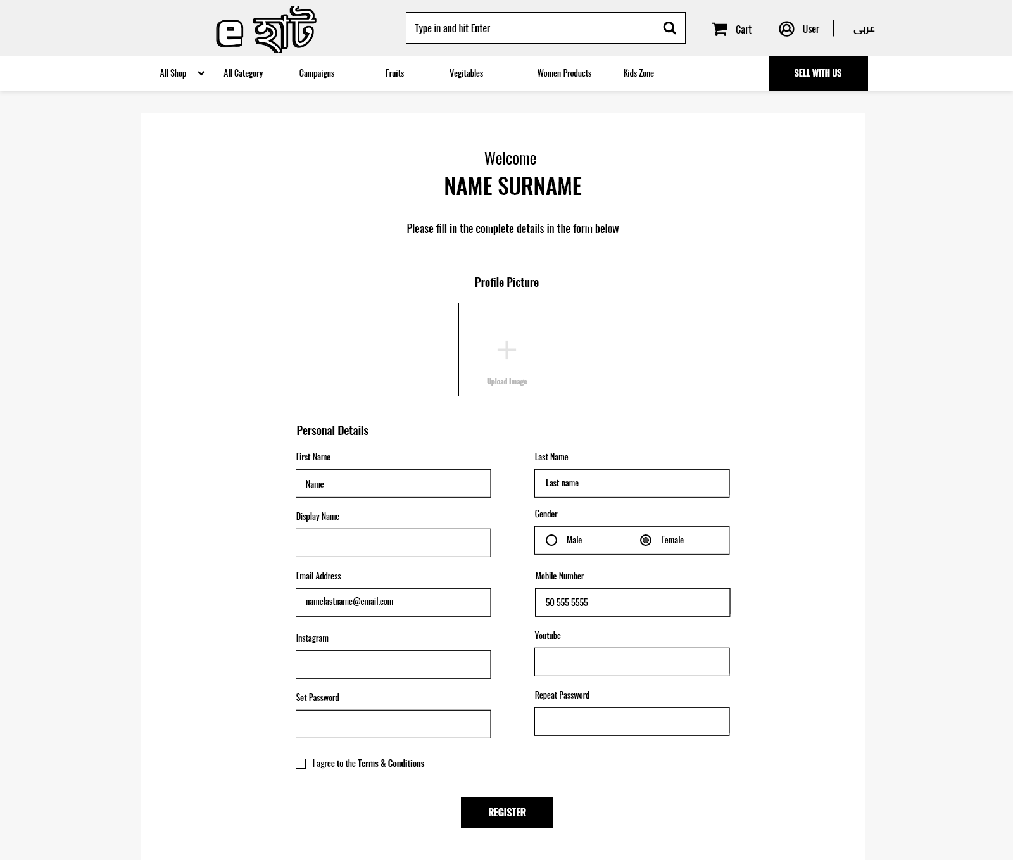
Prototype
User Registration

Slide 29
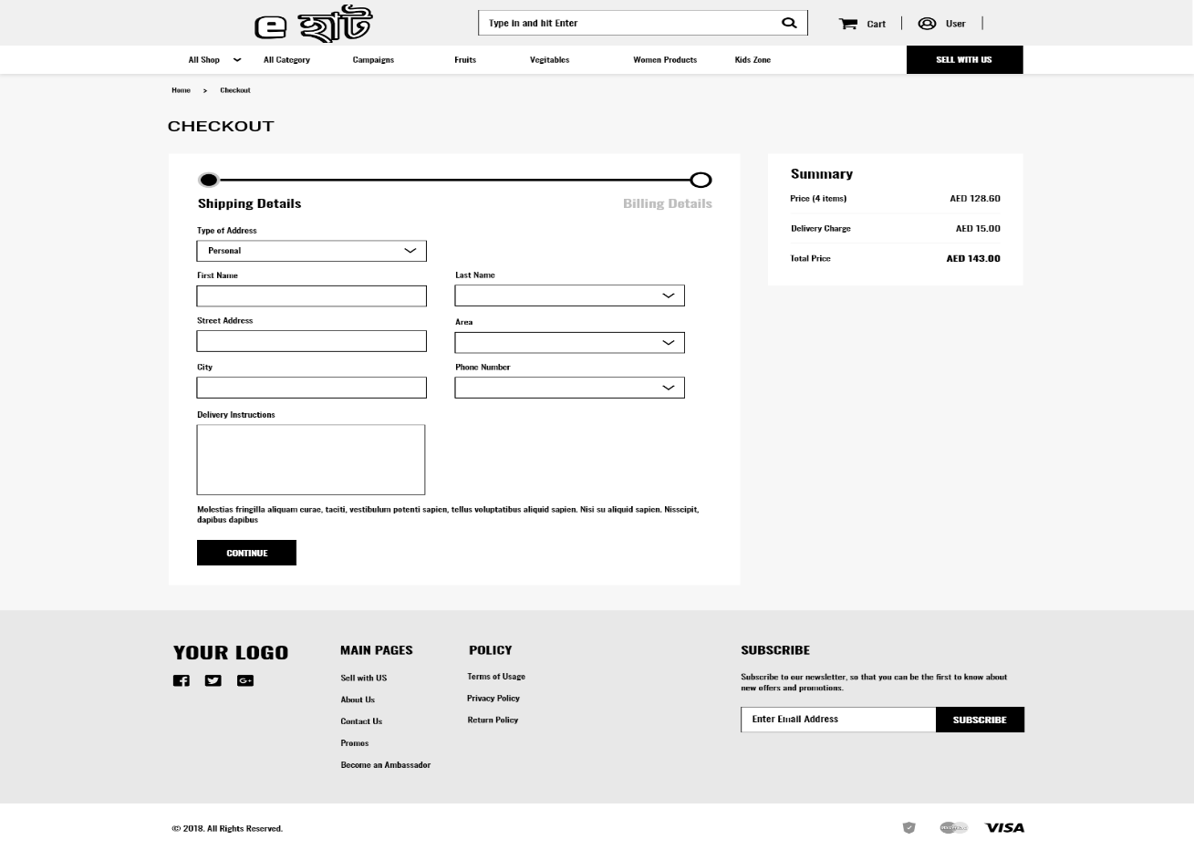
Prototype
Checkout

Slide 30
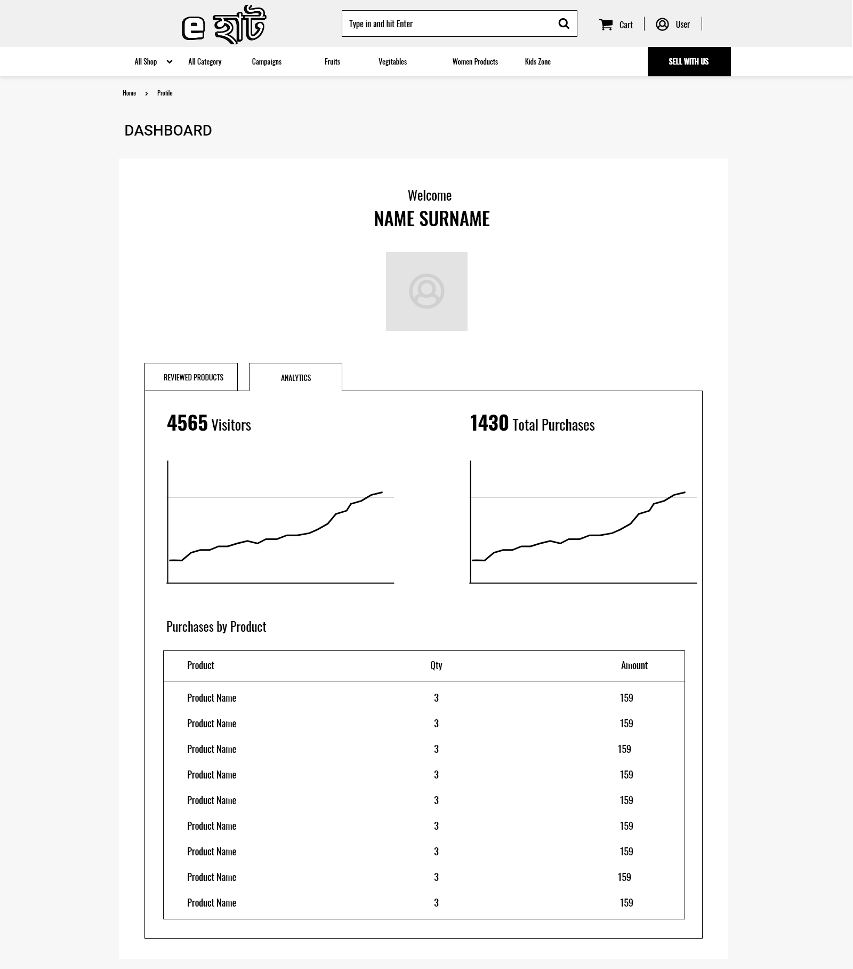
Prototype
Dashboard

Slide 31
Plannings
Initially four of ours team members work on this project
After collecting all the materials and resources we will start work by dividing task.
We will follow Scrum (Agile Process Model) during the project implementation
The quality of the deliverables should be improved.
Adapt to change more effectively
Produce more accurate predictions in less time
Have a better handle on the project's timetable and status.

Slide 32
Time & Cost
Project Time
Expected time of completion of project is 4 months.
Project Cost
Estimated service cost
Description | Cost Assumption
Resource buying | 20,000BDT
Site launch (hosting) | 45,000 BDT
Maintenance (1 year) | 30,000 BDT
Developers | 3,20,000 BDT
Grand total | 4,15,000 BDT

Slide 33
Risk Management
Risks | Probability | Impact | Rating
Project Manager Availability | 50% | 3 | Medium
Schedule slips | 70% | 4 | Low
Changes in Requirements | 30% | 1 | High
Computer Crash | 20% | 2 | Low
Lack of Development Experience | 30% | 4 | Medium
Programmers doesn’t have good experience | 20% | 1 | Medium
Poor Comments in Code | 40% | 2 | Low
Late delivery | 30% | 4 | Medium
Customer Participation in Beta Testing | 60% | 3 | Medium

Slide 34
Conclusion
This advanced e-commerce project of grocery delivery will definitely help the people in Dhaka city who are really busy in their daily lives.They can be able to save their most valuable time by not going to the groceries physically and also their money as we will work to ensure the best quality products for them.
As this project will be created from scratch, firstly the target will be to complete all the prioritized requirements of the project first.Then it will be tested by following the software testing methologies.After when it will be ready to use, then further development of the project will be approached.

Slide 35
Reference
Murphy, A. and Ledwith, A., 2007. Project management tools and techniques in high‐technology SMEs. Management research news.
Milosevic, D.Z., 2003. Project management toolbox: tools and techniques for the practicing project manager. John Wiley & Sons.
Abdul-Rahman, H., Wang, C., Takim, R. and Wong, S., 2011. Project schedule influenced by financial issues: Evidence in construction industry. Scientific Research and Essays, 6(1), pp.205-212.
Smith‐Daniels, D.E. and Aquilano, N.J., 1987. Using a late‐start resource‐constrained project schedule to improve project net present value. Decision Sciences, 18(4), pp.617-630.
Davis, A., Overmyer, S., Jordan, K., Caruso, J., Dandashi, F., Dinh, A., Kincaid, G., Ledeboer, G., Reynolds, P., Sitaram, P. and Ta, A., 1993, May. Identifying and measuring quality in a software requirements specification. In [1993] Proceedings First International Software Metrics Symposium (pp. 141-152). Ieee.
Belfo, F., 2012. People, organizational and technological dimensions of software requirements specification. Procedia Technology, 5, pp.310-318.
Royce, W., 1998. Software project management. Pearson Education India.
Reggio, G., Leotta, M., Ricca, F. and Clerissi, D., 2013. What are the used UML diagrams? A Preliminary Survey. EESSMOD@ MoDELS, 1078(10).
Mishra, A. and Mishra, D., 2013. Software project management tools: a brief comparative view. ACM SIGSOFT Software Engineering Notes, 38(3), pp.1-4.
Goold, M. and Campbell, A., 2003. Making Matrix Structures Work:: Creating Clarity on Unit Roles and Responsibility. European Management Journal, 21(3), pp.351-363.
Colomo-Palacios, R., Casado-Lumbreras, C., Soto-Acosta, P. and García-Crespo, Á., 2013. Decisions in software development projects management. An exploratory study. Behaviour & Information Technology, 32(11), pp.1077-1085. Schwaber, K. and Beedle, M., 2002. Agile software development with Scrum (Vol. 1). Upper Saddle River: Prentice Hall.
Woodhouse, D., 1999. Quality and quality assurance. Quality and internationalisation in higher education.
Heinemann, L., Hummel, B. and Steidl, D., 2014, May. Teamscale: Software quality control in real-time. In Companion Proceedings of the 36th International Conference on Software Engineering (pp. 592-595).

